Slide 1


Time-series forecasting of daily PM2.5 air pollution levels using Temporal Fusion Transformer (TFT) model
Andrija Stanišić, Stefanela Stevanović

Slide 2

Introduction
Long-term exposure to high PM2.5 (fine particulate matter less than 2.5 micrometers) levels is associated with serious health risks, including cardiovascular and respiratory diseases.
Project Goal:
Develop a forecasting model for daily PM2.5 levels.
Focus on interpretability to understand drivers of PM2.5 fluctuations.
Why Temporal Fusion Tranformer?
State-of-the-art performance for time-series forecasting.
Effectively handles multi-variable inputs (e.g., meteorological data and past PM2.5 levels).
Supports multi-time series forecasting (e.g., across multiple locations).
Built-in interpretability tools to highlight feature importance and temporal dynamics.

Slide 3
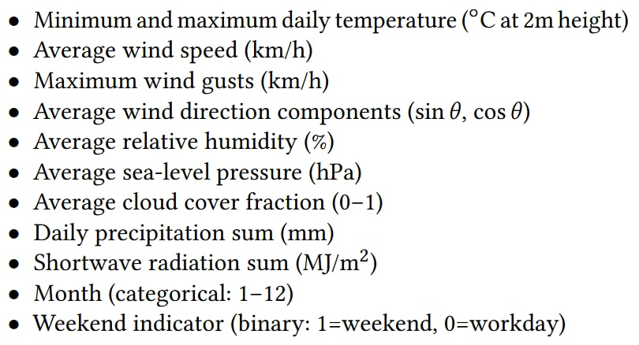
Data
Historical daily PM2.5 levels (Jan 2022 - May 2025) (https://aqicn.org)
2 stations: Ljubljana (Bežigrad) and Belgrade (Stari Grad)
Historical meteorological data (https://open-meteo.com)
Final feature set:
Lagged features (t-1): Added 1-day lags for all features to capture temporal dependencies.
Sequential split: Training (1,036 days), validation (100 days), and test (100 most recent days) sets—preserving temporal order to prevent data leakage.
Notes:
Why not hourly?

Slide 4
Training
Model: Temporal Fusion Transformer (TFT) implemented in PyTorch
Prediction Length: 5-day PM2.5 forecasts (assuming meteorological forecasts are reasonably reliable within this window)
Lookback Period: 60 days of historical data for encoder analysis
Hyperparameter Optimization (via Optuna, 15 trials):
Batch size: 64
Dropout rate: 0.2
Hidden size: 32
Hidden continuous size: 4
Attention head size: 4
Learning rate: 0.016 (dynamically adjusted via scheduler)
Early stopping
Loss function: Quantile loss
Validation: Sliding-window approach (size=5 days, stride=1) on 100 days validation data

Slide 5
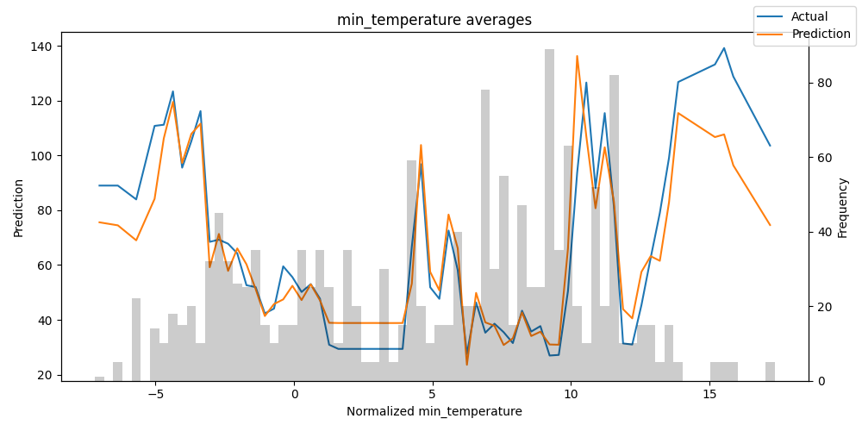
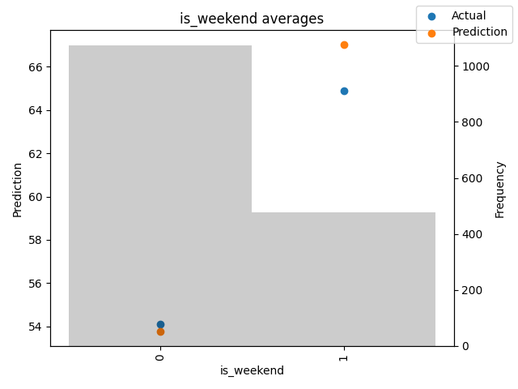
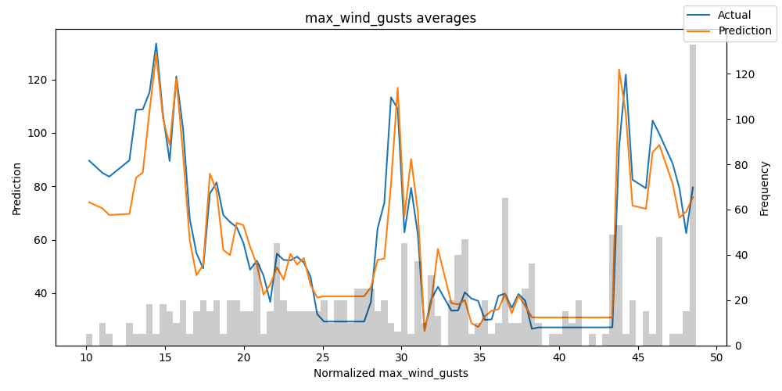

Slide 6
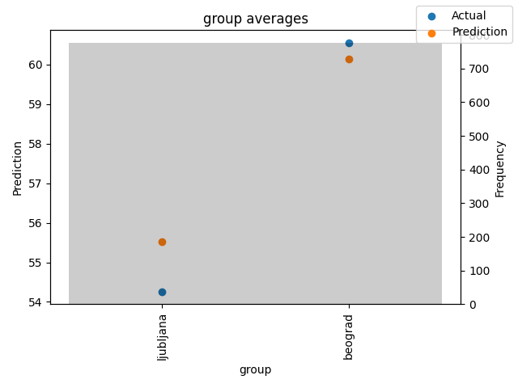
Model Performance
Naive baseline:
Use last week’s value as this week’s forecast.
Evaluation method:
Non-overlapping 5-day windows (20 total).
Metrics: RMSE & MAE per window, averaged across all windows.
 | Naive Baseline |  | TFT
 | Ljubljana | Belgrade | Ljubljana | Belgrade
Avg. Window RMSE | 30.34 ± 21.13 | 27.51 ± 16.05 | 13.68 ± 8.96 | 12.38 ± 4.83
Avg. Window MAE | 26.63 ± 19.46 | 22.50 ± 13.69 | 11.33 ± 7.76 | 10.56 ± 4.05

Slide 7


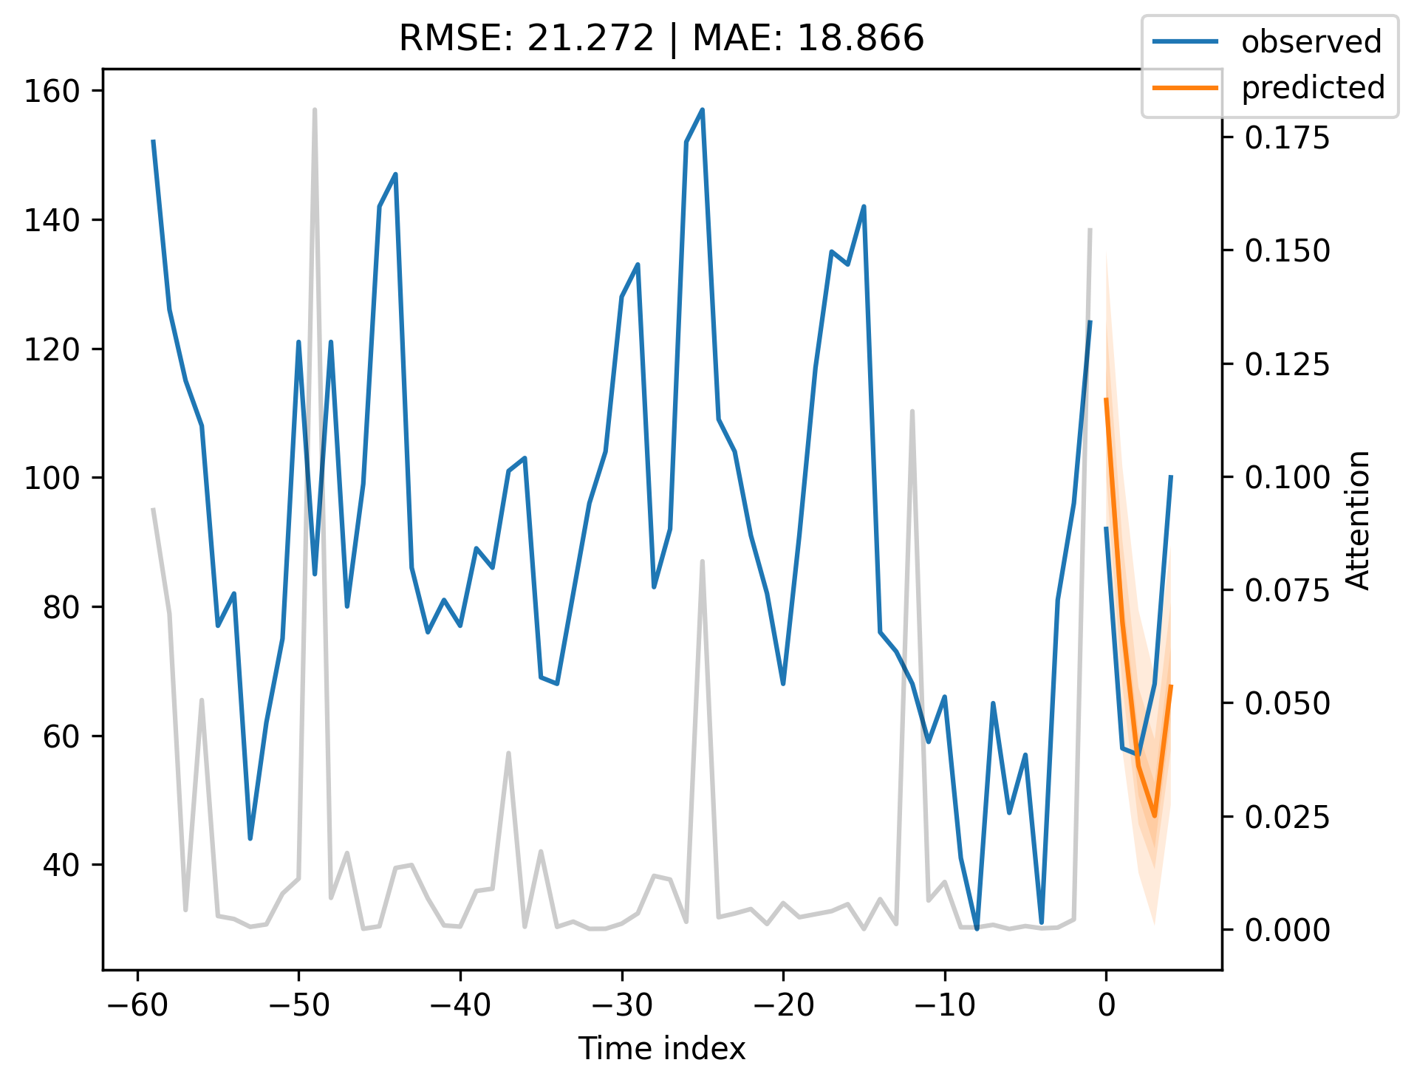
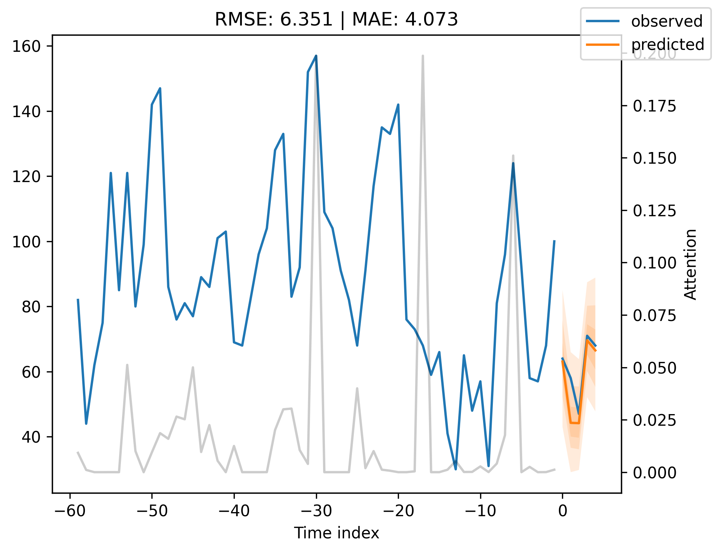
Notes:
Explain attention

Slide 8
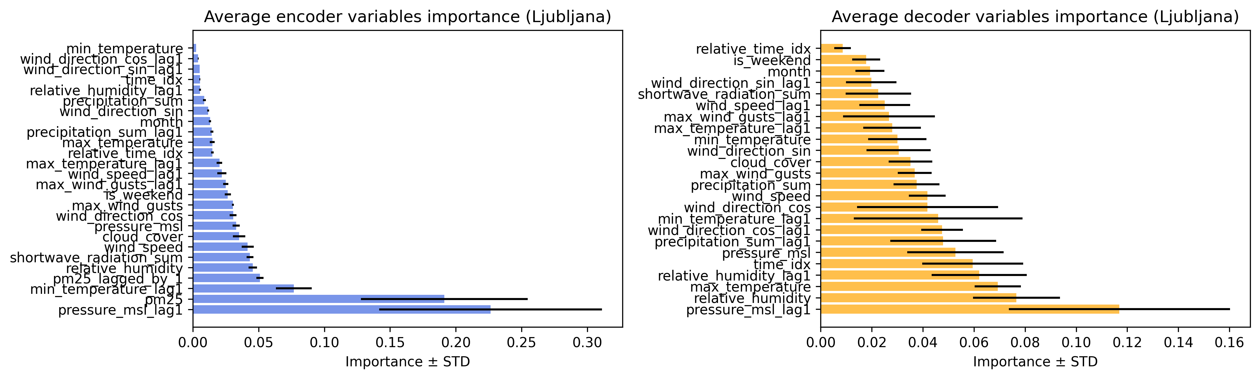
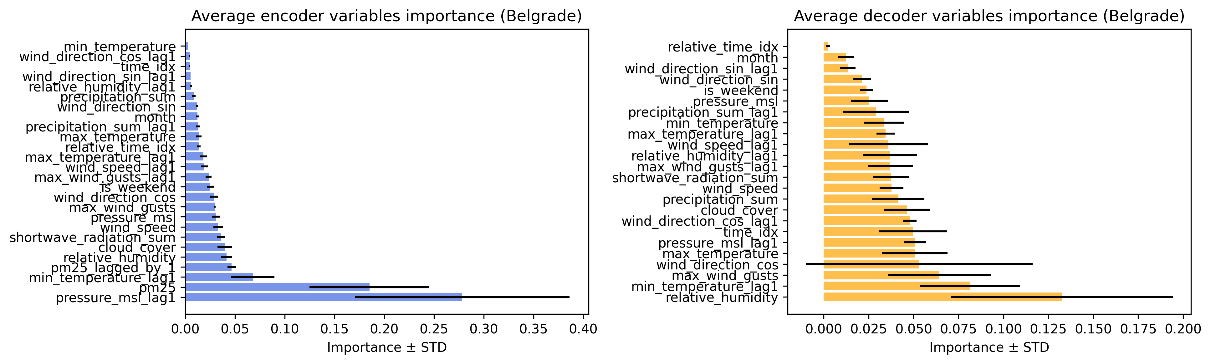
Notes:
Wind plays more role in Belgrade
Pressure above pm25, why and how? – mean sea level pressure – it governs temperature inversion. High-pressure systems often lead to sinking air, which suppresses vertical mixing and traps pollutants near the surface, increasing PM2.5 concentrations. Winter: High pressure + cold temperatures + inversions → PM2.5 buildup (e.g., in valleys like Beijing or Delhi).
Summer: High pressure + heat can also trap pollutants, especially with stagnant air (e.g., Los Angeles smog).

Slide 9


Thank you for your attention!
Any questions?

